Slide 1

Please connect to the cluster while waiting for the session to begin…
Credit: XKCD

Slide 2
An Introduction to HPC Online Training Workshop 2022

Slide 3


Welcome & virtual housekeeping
90+ applicants
huge mixture of experience from none -> some -> lots
Multiple presenters/helpers
Talks, hands on practice & discussions
view slides & SSH client window simultaneously
Let’s make it interactive – shout out or use the chat function
please keep your video ON
we’ll also have breakout rooms for 1-to-1 help
we’re recording; but it’ll never be made public
5min break at the end of each hour, but time might be tight
This is always challenging: if there are technical glitches please bear with us!

Slide 4


Who we are
Iain Milne (JHI) – Head of Research Computing
Micha Bayer (JHI) – Bioinformatics Specialist
Fraser MacFarlane (JHI) – Research Software Engineer / Image Analyst
Becky Smith (JHI) – Research Software Engineer
Peter Thorpe (UoSA) - Senior Bioinformatician
Larry Percival-Alwyn (NIAB) - Senior Bioinformatician
Contact: Iain Milne (iain.milne@hutton.ac.uk)

Slide 5

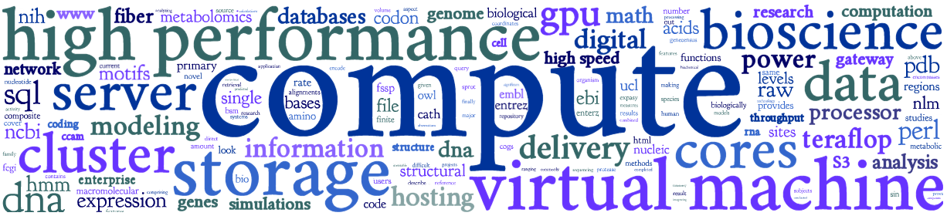
Outcomes of workshop
Overview of Crop Diversity HPC & compute resources
Connect to cluster and complete common tasks
Understand basics of job submissions with Slurm
Use bioconda package manager and containers
Understand basics of workflows
Know cluster etiquette & how to get further help
Compare CPU and GPU processing
Not time to get hands on experience of everything: further training
Data Carpentry https://datacarpentry.org/
Software Carpentry https://software-carpentry.org/

Slide 6






Crop Diversity HPC
Initially funded by the BBSRC
For use by:
JHI, NIAB, SRUC
RBGE, RBGK, NHM
3,600 processors
25-gigabit networking
1.7 PB of storage
1.0 PB of backup
350+ users

Slide 7
HPC overview
High-performance computing (HPC) is the use of supercomputers and parallel computing techniques to solve complex computational problems
user’s desktop
connect to cluster (SSH)
shared
storage
head node
n1
n2
n3
n4
worker/child/compute nodes
all nodes are running the Linux distribution known as Rocky Linux (version 8.x)
Notes:
Supercomputers vs clusters vs PCs

Slide 8
https://help.cropdiversity.ac.uk/

